Slide 1
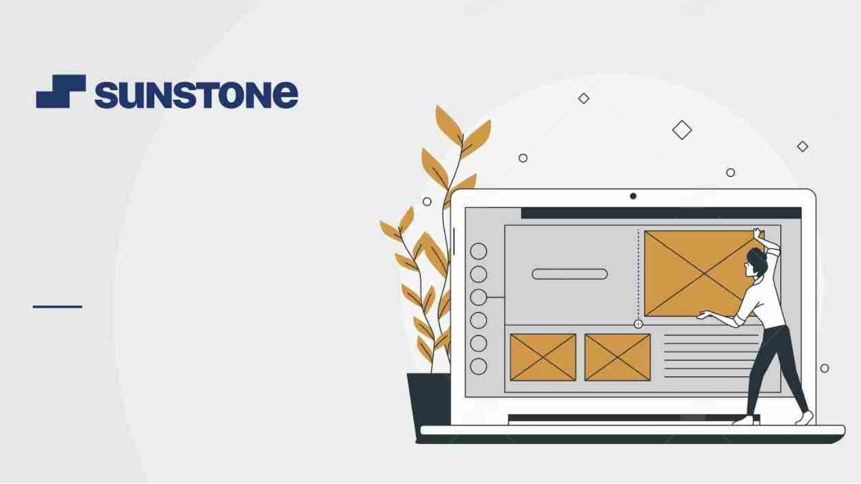
“MONEY TRANSFER
APPLICATION”
Task - 1

Slide 2
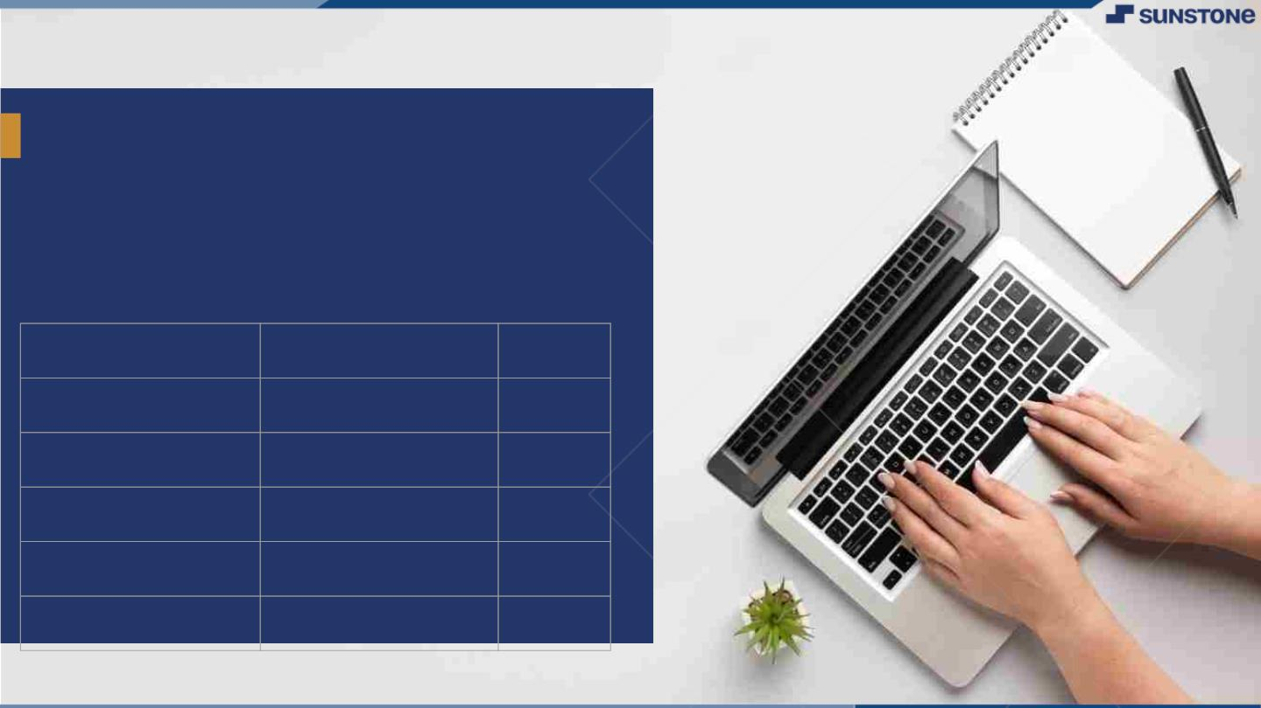
Money Transfer Application
▪
A Money Transfer Application offers a secure and user-friendly solution for seamless fund transfers and financial management, empowering developers to create a cutting-edge financial tool.
LMS Username
Name
Batch
au420420205018
Naveenkumar I
CA2
au420420205003
Baranidharan R
CA2
au420420205008
Gokulakrishnan K
CA2
au420420205306
Vasanthkumar J S
CA2

Slide 3
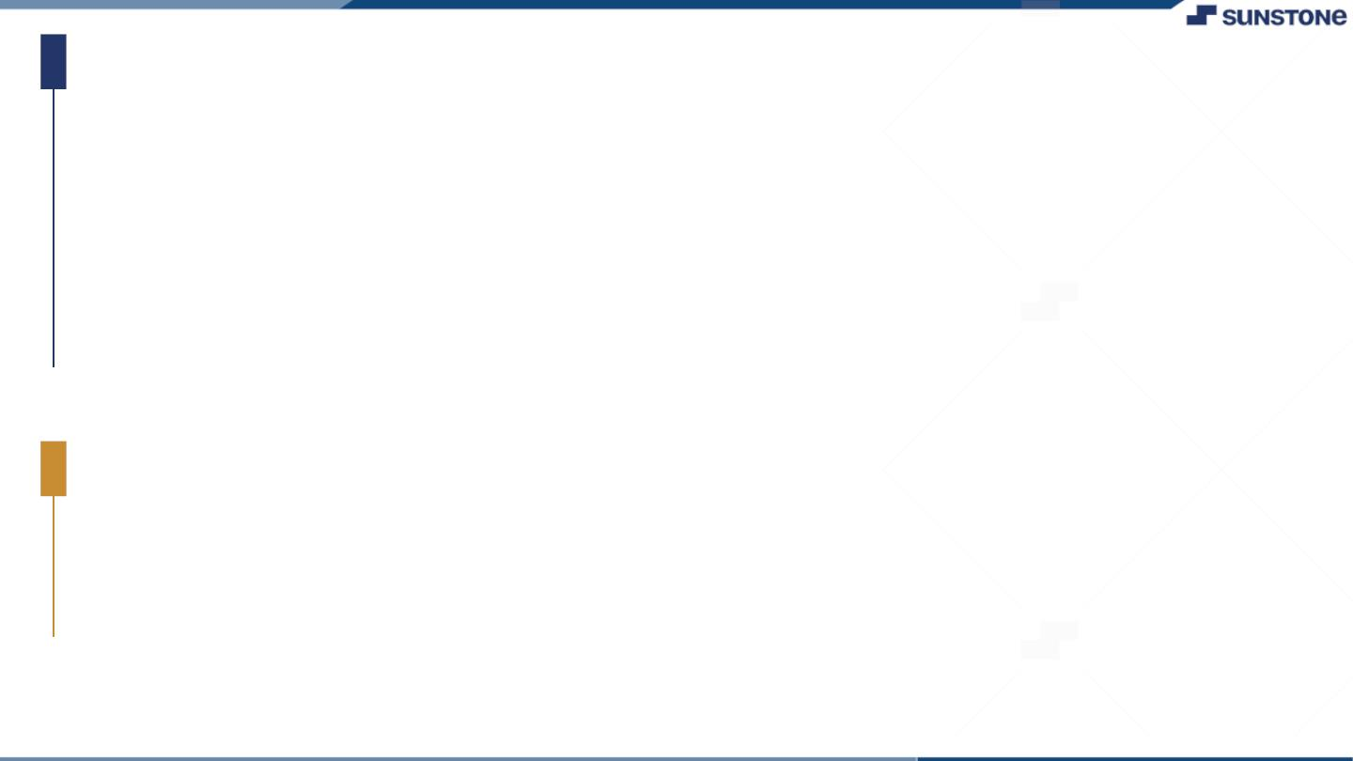
Task-1
Creation of SRS &Github
▪
▪
▪
Create SRS:“Money Transfer Application”
Creation &Set-up of Github account
Creation &Hands-on to various commands of Git Bash
Evaluation Metric:
● 100% Completion of the above tasks
Learning Outcome
▪
▪
▪
▪
Get to know about different lifecycle models.
Understanding importance and how to create an SRS
Knowing various commands of Github
Understanding agile and scrum management techniques for efficient product development

Slide 4
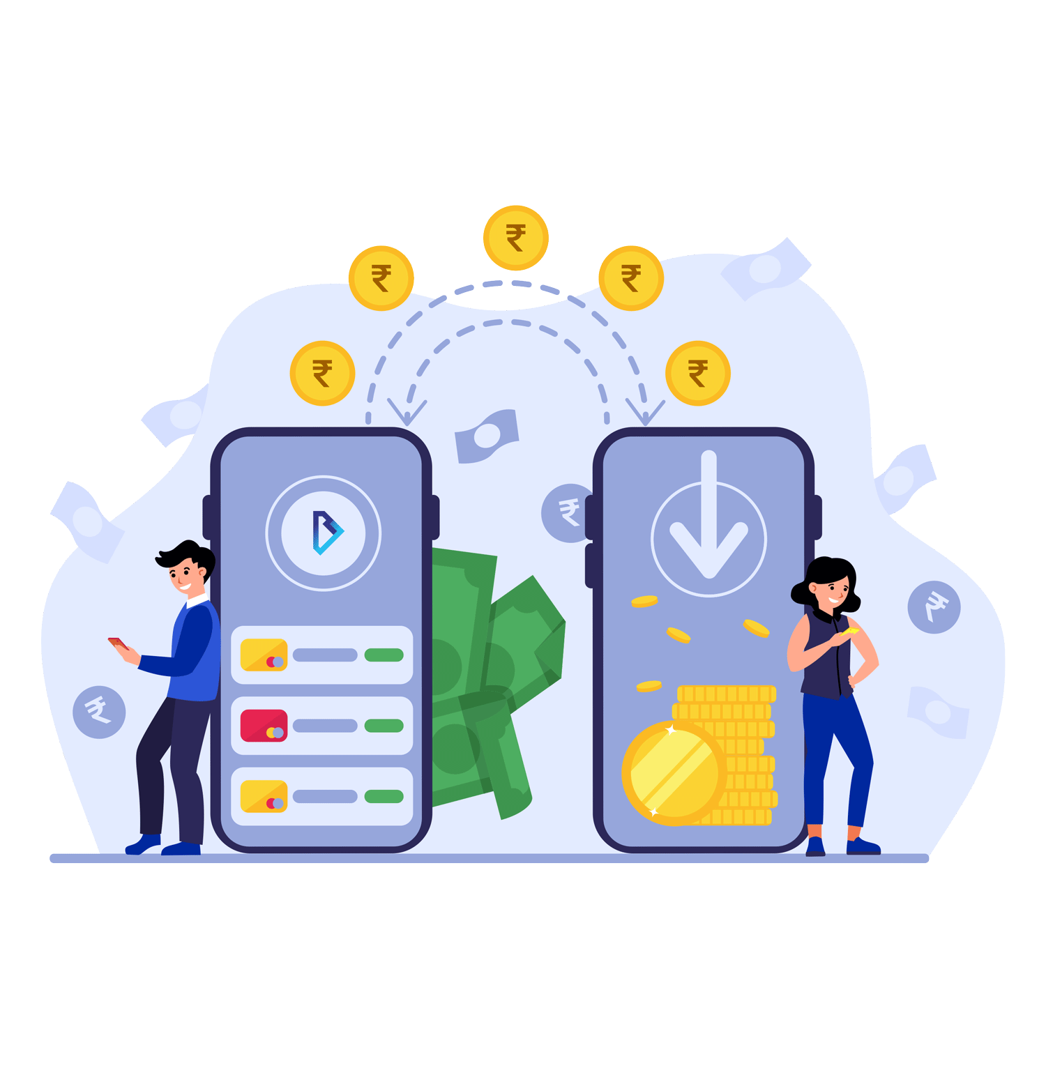

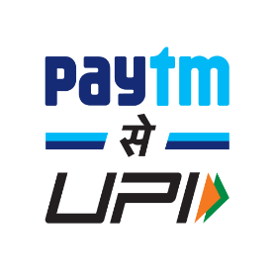
Introduction:
A secure and user-friendly solution revolutionizing financial transactions. With features like instant transfers, robust security, and 24/7 accessibility, we empower users to take control of their finances conveniently and efficiently. Join us in reshaping the future of money management.
Examples:
Google Pay (GPay) is a digital wallet and payment platform by Google, allowing users to send money, make purchases, and store payment information securely on their mobile devices. It offers convenience and security in managing financial transactions and is widely accepted at various merchants and online services.
Paytm is an Indian digital wallet and e-commerce platform that provides a wide range of services, including mobile recharges, bill payments, online shopping, and money transfers. It's known for its widespread adoption and the convenience it offers for various financial transactions.

Slide 5
Steps Involved in Development
Step-Wise Description
1. Project Planning and Design:
Define the application's scope, features, and target audience.
Create a detailed system design, including data models, user interfaces, and architecture.
2. Front-End Development:
Develop the user interface using HTML, CSS, and JavaScript.
Implement user registration, login, and account management screens.
Integrate with APIs or libraries for user interactions.

Slide 6
Step-Wise Description
3. Back-End Development:
Set up a server-side environment using Java.
Use a framework like Spring Boot for rapid development.
Implement user authentication, authorization, and session management.
Create RESTful APIs for handling money transfers, balance checking, and transaction history.
4. Database Setup:
Choose a database system (e.g., MySQL, PostgreSQL) and set it up.
Create database schemas and tables to store user data, account balances, and transaction records.
Implement database connectivity in your Java application using JDBC or an ORM (Object-Relational Mapping) framework.

Slide 7
Step-Wise Description
5. Security Implementation:
Prioritize security with encryption for sensitive data (e.g., passwords, transaction details).
Implement secure communication protocols (HTTPS).
Apply input validation to prevent common security vulnerabilities.
6. Testing:
Perform unit testing to validate individual components and functions.
Conduct integration testing to ensure seamless interactions between front-end and back-end.
Perform user acceptance testing to verify the application's usability.

Slide 8
Step-Wise Description
7. Deployment:
Deploy the application on a web server or cloud platform.
Configure domain settings and ensure scalability and availability.
Set up monitoring and error logging for maintenance.
8. User Documentation:
Create user guides or documentation to help users understand how to use the application effectively.

Slide 9
SUMMARY
SUMMARY
Step-Wise Description
A Money Transfer Application developed using Full-Stack Java is a comprehensive software solution that enables users to manage financial transactions efficiently and securely. This application encompasses both front-end and back-end development, offering features such as user registration, authentication, fund transfers, balance checking, and transaction history. It leverages technologies like Java, Spring Boot, HTML, CSS, and JavaScript for seamless user experiences and robust security measures. Building such an application involves careful planning, database integration, rigorous testing, and ongoing maintenance to provide users with a reliable and convenient platform for managing their finances.

Slide 10
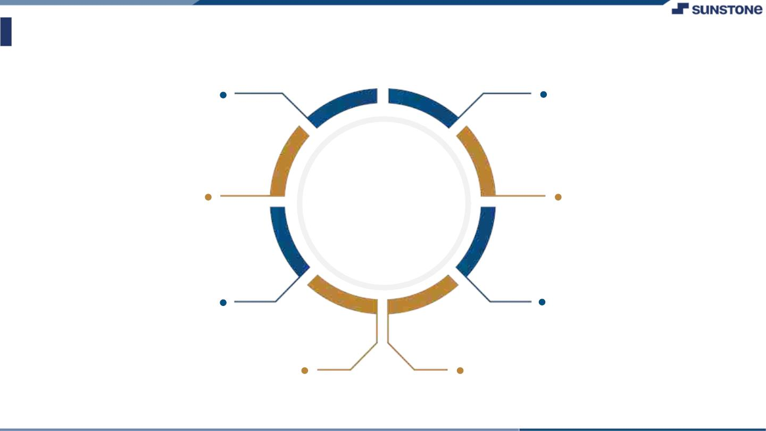
Assessment Parameter
Gather requirements for the
project
Add Readme.md file with
Description of the project
Prepare databasedesign
schemas
Check-List
Commit all changes with"first
commit"
Get your initial project
Structure ready
create arepository on github Realted to project
Initiate a git repository
Push your change to github

Slide 11
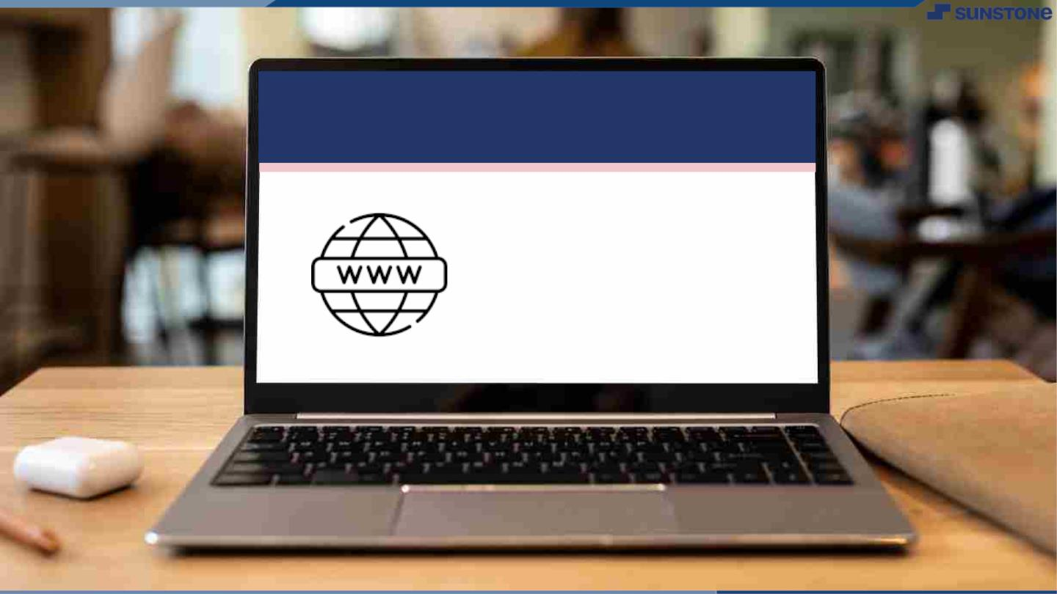
Submission Github
https://github.com/Naveenkumar-17/NM-APEC-IT-GROUP1

Slide 12


